Slide 1
Scalable Deep Learning on Distributed Infrastructures:
Challenges, Techniques and Tools
户玉拓

Slide 2
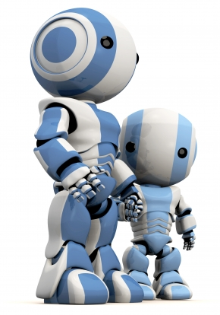
Introduction
Foundations of DL
Distributed deep learning
Infrastructure used in large DL
Methods for parallel DL training
Optimizations for Data Parallelism

Slide 3
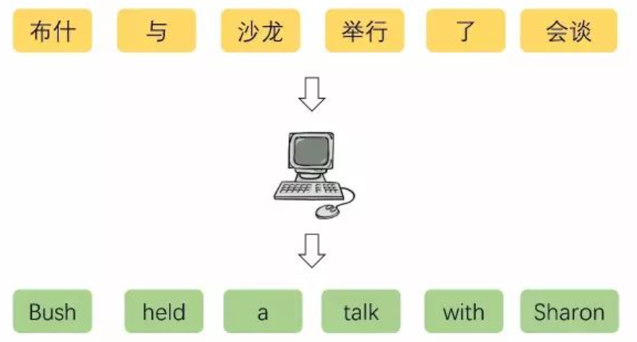
Introduction
medical image analysis
machine translation
the scale of training in three dimensions
size and complexity of the models
amount of training data
scale of the infrastructure

Slide 4
Introduction
Foundations of DL
Distributed deep learning
Infrastructure used in large DL
Methods for parallel DL training
Optimizations for Data Parallelism

Slide 5
Foundations of DL
Context of Deep Learning
relationship between AI, ML and DL

Slide 6
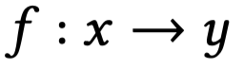
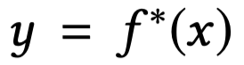
Deep Neural Networks
neural network (NN)
The goal
the weights, biases and thresholds are adjusted by applying back-propagation to the gradient of the loss function

Slide 7
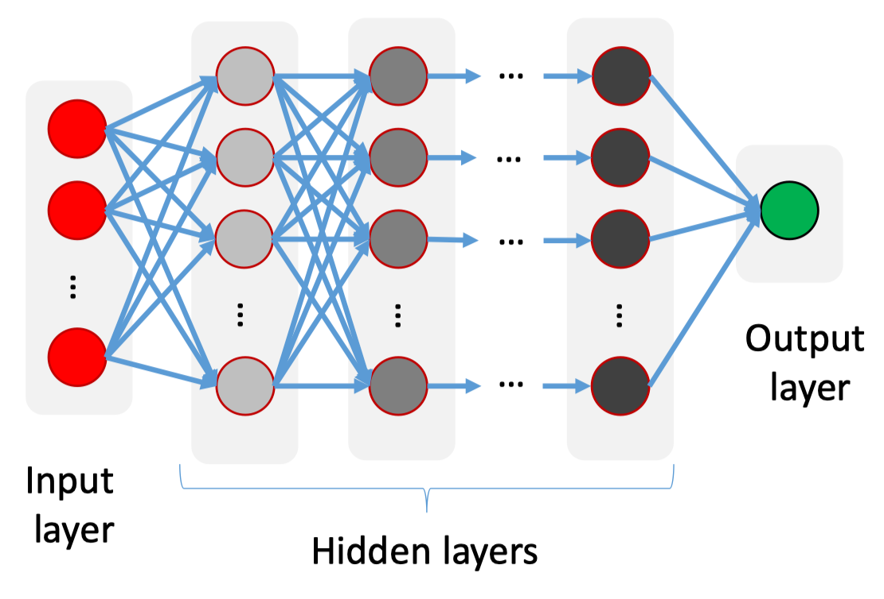
Neural Network Architectures
Schematic of a multi-layer perceptron.
MLPs have limitations.
have a large number of weights
not robust against geometric translations and local distortions of the inputs.
agnostic to the topology of the input

Slide 8
Neural Network Architectures
Convolutional neural networks
Convolutional layers are only connected to sub-areas of their respective previous layers
A convolutional layer is composed of multiple planes, weight sharing
Convolutional layers alternate with sub-sampling layers

Slide 9
Neural Network Architectures
recurrent neural networks

Slide 10
Neural Network Architectures
Autoencoders
extract significant features from the training data
consists of an encoder, a code, and a decoder
the output layer has the same number of neurons as the input layer

Slide 11
Neural Network Architectures
generative adversarial networks (GANs)
a generative and a discriminative NN

Slide 12
Introduction
Foundations of DL
Distributed deep learning
Infrastructure used in large DL
Methods for parallel DL training
Optimizations for Data Parallelism

Slide 13
Distributed Deep Leanring
Distributed deep learning is performed in a distributed infrastructure of multiple compute nodes, each of which may be equipped with multiple GPUs.
This brings a number of challenges.
the processing resources must be effectively used
the compute, storage and network resources are typically shared among different users or training processes

Slide 14
Introduction
Foundations of DL
Distributed deep learning
Infrastructure used in large DL
Methods for parallel DL training
Optimizations for Data Parallelism

Slide 15
Infrastructure used in large DL
Hardware innovations
data-center scale infrastructure
GPU
FPGA
TPU
Euromorphic hardware
cuDNN
NCCL

Slide 16
Large-scale infrastructure for DL
A large-scale DL infrastructure is composed of many inter-connected hardware components that together build a warehouse-scale computer.
ML infrastructure in facebook

Slide 17
Large-scale infrastructure for DL
Tencent also employs a heterogeneous infrastructure with both CPUs and GPUs

Slide 18
Google
they employ TPUs, which are custom ASICs,
exploit specialized interconnects and use multiple communication protocols
In academic research. exploiting high-performance computing (HPC) infrastructures for DL training is a topic of increasing importance.

Slide 19
Introduction
Foundations of DL
Distributed deep learning
Infrastructure used in large DL
Methods for parallel DL training
Optimizations for Data Parallelism

Slide 20
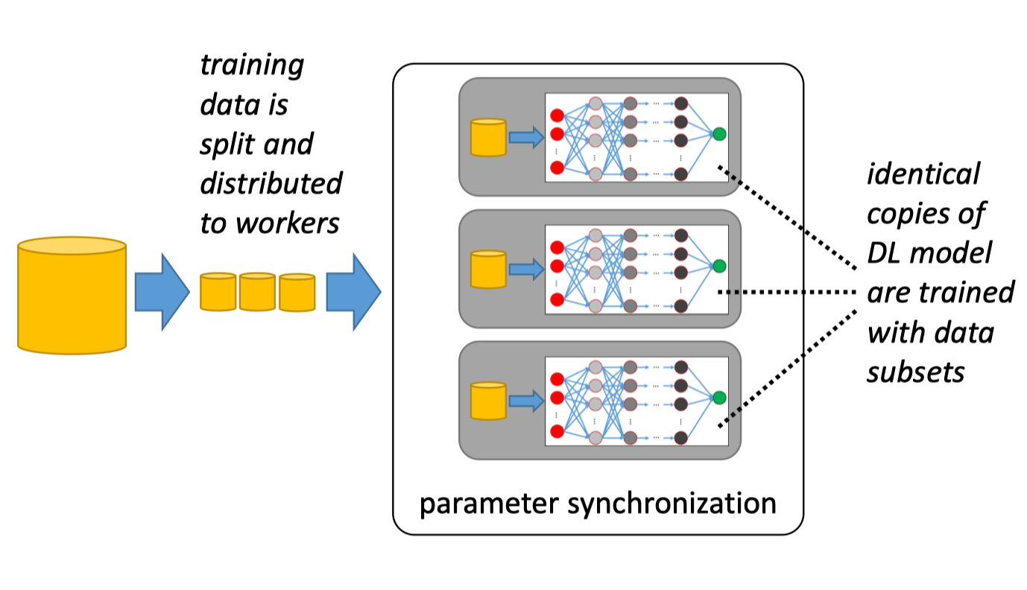
Parallelization Methods
Data Parallelism
Data parallelism.

Slide 21
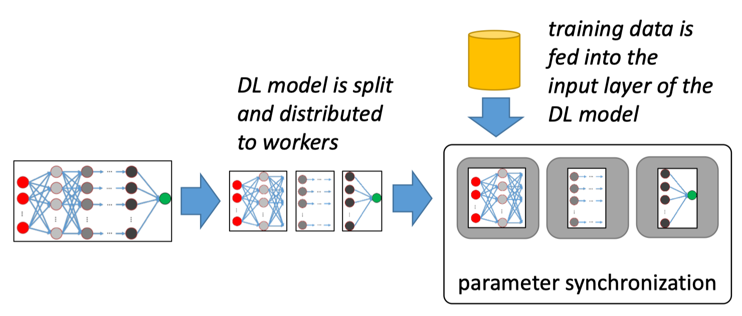
Parallelization Methods
Model parallelism.
Model parallelism.

Slide 22
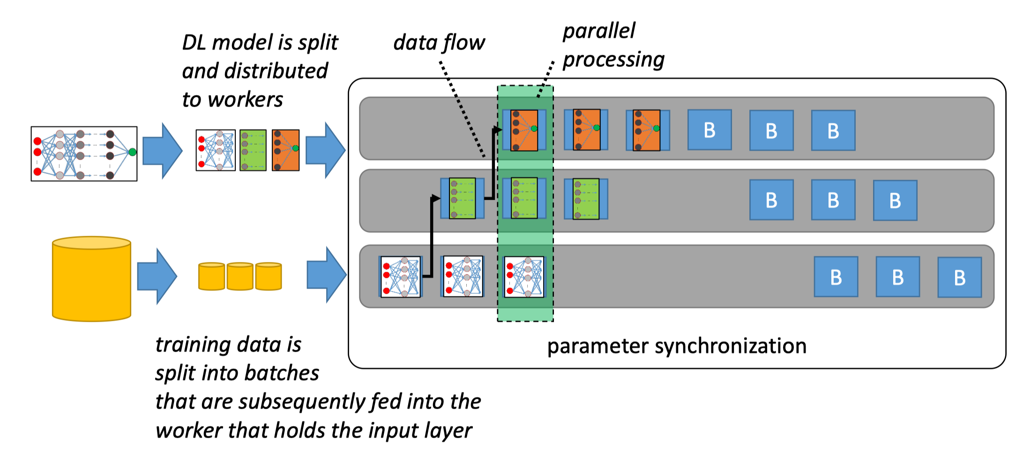
Parallelization Methods
Pipeline Parallelism.
Pipeline Parallelism.

Slide 23
Introduction
Foundations of DL
Distributed deep learning
Infrastructure used in large DL
Methods for parallel DL training
Optimizations for Data Parallelism

Slide 24
Optimizations for Data Parallelism
Parameter synchronization in data-parallel DL systems poses three major challenges.
how to synchronize the parameters
when to synchronize the parameters.
how to minimize communication
System Architecture
Synchronization
Communication

Slide 25
System Architecture
The system architecture describes how the parameters of the different workers are synchronized.
provide a scalable system architecture than can deal with a large number of parallel workers
keep the system easy to configure
exploit lower-level primitives

Slide 26
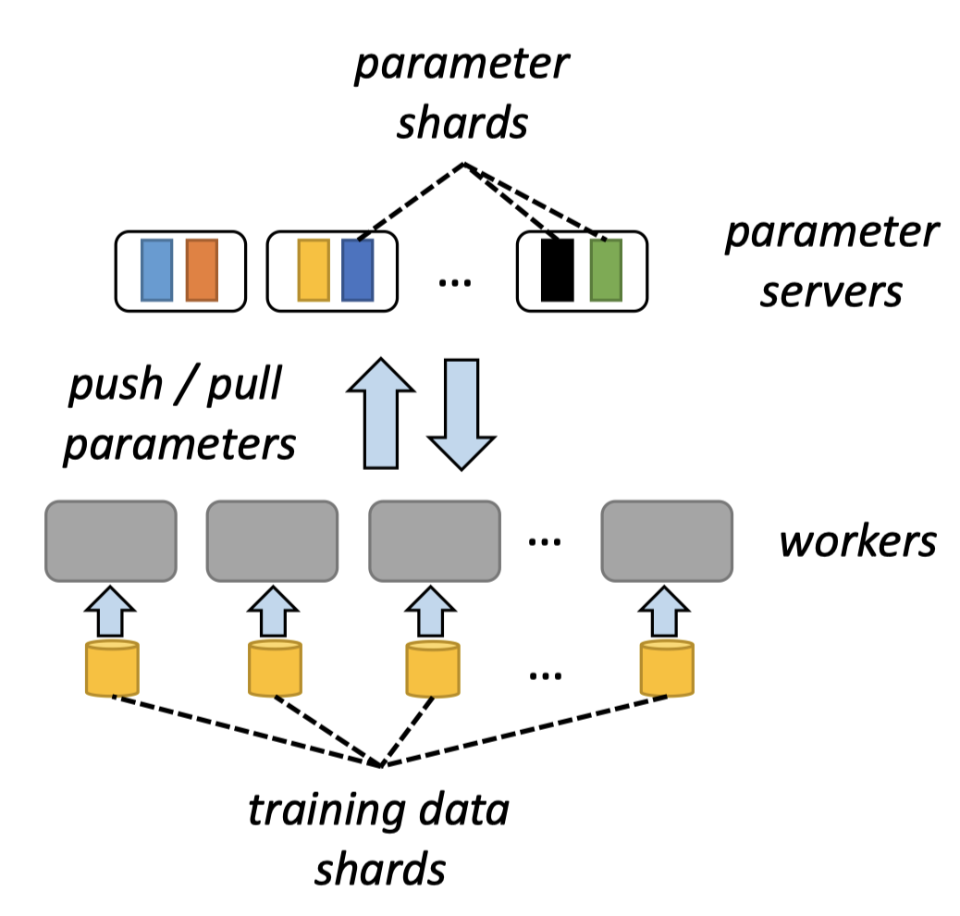
System Architecture
Centralized
Parameter server architecture

Slide 27
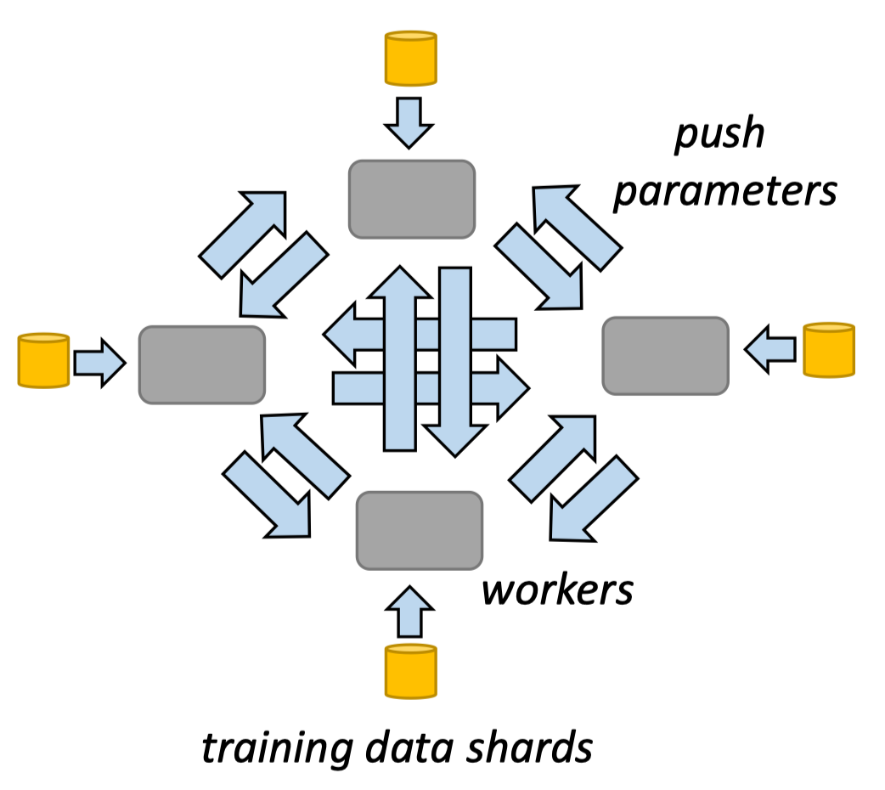
System Architecture
Decentralized
All-reduce architecture.

Slide 28
System Architecture

Slide 29
System Architecture
Advantages of decentralized architecture
avoid the need to deal with the inconveniences of implementing and tuning a parameter server.
fault tolerance can be achieved more easily
Disadvantages of decentralized architecture
communication in the decentralized architecture increases quadratically with the number of workers, if no countermeasures are taken.

Slide 30
System Architecture
Federated
Federated architecture

Slide 31
Synchronization
The main challenge in parameter synchronization is to handle the trade-off between the potential loss in training quality or convergence speed when workers perform training on a stale DL model and the synchronization cost to update the DL model on the workers.
there are three different main approaches:
Synchronous
bounded asynchronous
asynchronous

Slide 32
Synchronization
Synchronous
after each iteration (processing of a batch), the workers synchronize their parameter updates.
Bounded asynchronous.
small deviations and non-determinism in the training process do not necessarily harm the model accuracy.
Asynchronous
workers update their model completely independently from each other.

Slide 33
Communication
The main challenge in optimizing the communication is to prevent that communication becoming the bottleneck of the overall training process
There are three main approaches for communication efficiency:
Reducing the model precision
compressing the model updates
improving the communication scheduling.

Slide 34
Communication
Reducing the model precision
saves communication bandwidth
reduces the model size
Compressing the model updates.
gradient quantization
gradient sparsification
Communication scheduling
the communication of the different workers can be scheduled
can prioritize specific messages over

Slide 35
THANKS！

